Slide 1

Solar system creator
Mayk Al-Ghrawi

Slide 2
Introduction: Solar System creator
The Solar System Creator is a C++ program that enables users to create and simulate their own solar systems. With a variety of customizable celestial bodies, users can build unique and dynamic systems that explore the fascinating properties of planets, moons, and other astronomical phenomena. By providing tools to calculate important astronomical parameters.
The Solar System Creator is fun to play around with but also learn from.

Slide 3
Overview: features and capabilities
Customizable celestial bodies: Add planets and moons with custom names, masses, and radii.
Calculate orbital periods of each celestial body.
Calculate escape velocity of each body.
Calculate surface gravity of each body.
Access all features through a terminal menu system.
Ideal for students and educators to learn about astronomy and physics in a fun and engaging way.
Encourages creative experimentation and design of new solar systems.

Slide 4
Factors affecting calculation
Orbital period: The orbital period of a celestial body is affected by its distance from the central body and the mass of the central body. The greater the distance from the central body, the longer the orbital period. Similarly, the greater the mass of the central body, the longer the orbital period.
Escape velocity: The escape velocity of a celestial body is affected by its mass and radius. The greater the mass and radius, the higher the escape velocity required to escape its gravitational pull.
Surface gravity: The surface gravity of a celestial body is affected by its mass and radius. The greater the mass and smaller the radius, the stronger the surface gravity.

Slide 5

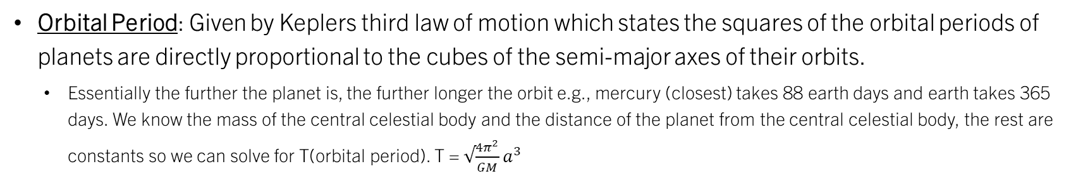
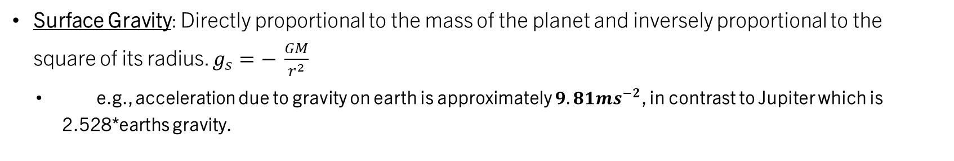
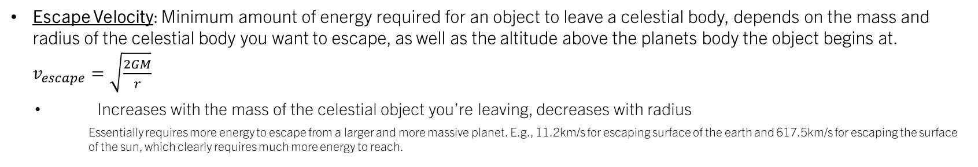
Calculating
Universal Gravitational Constant $G =6.67 × {10}^{−11} N m^{2} {kg}^{−2}$
Orbital Period: Given by Keplers third law of motion which states the squares of the orbital periods of planets are directly proportional to the cubes of the semi-major axes of their orbits.
Essentially the further the planet is, the further longer the orbit e.g., mercury (closest) takes 88 earth days and earth takes 365 days. We know the mass of the central celestial body and the distance of the planet from the central celestial body, the rest are constants so we can solve for T(orbital period). T = $√\frac{4π^{2}}{GM}a^{3}$
$T^{2}$=$\frac{4π^{2}a^{3}}{GM}$
Escape Velocity: Minimum amount of energy required for an object to leave a celestial body, depends on the mass and radius of the celestial body you want to escape, as well as the altitude above the planets body the object begins at. $v_{escape}=\sqrt{\frac{2GM}{r}}$
Increases with the mass of the celestial object you’re leaving, decreases with radius
Essentially requires more energy to escape from a larger and more massive planet. E.g., 11.2km/s for escaping surface of the earth and 617.5km/s for escaping the surface of the sun, which clearly requires much more energy to reach.
Surface Gravity: Directly proportional to the mass of the planet and inversely proportional to the square of its radius. $g_{s}=− \frac{GM}{r^{2}}$
e.g., acceleration due to gravity on earth is approximately $9.81ms^{−2}$, in contrast to Jupiter which is 2.528*earths gravity.

Slide 6
Further functionality
Code requires sanity checks to assure user inputs the correct things, otherwise it starts to bug out.
More interesting implementations (more complex astrophysical concepts) that can be used to add further educational elements, i.e., galaxy creator, adding black holes, total energy output of a star etc.
GUI/visual representation of your solar system in real time.
Any other constructive feedback my great peers would be willing to offer!

Slide 7
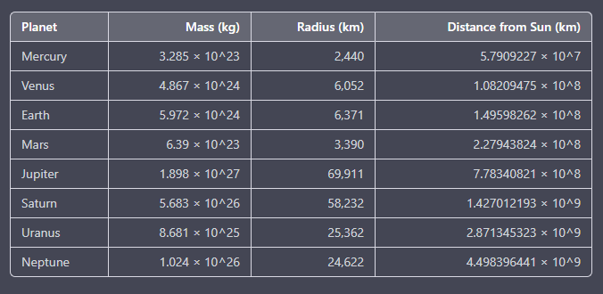
Thank you! Onto the demonstration..

